Slide 1
Classifying Data

Slide 2
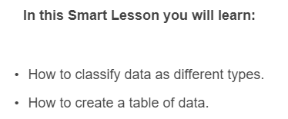
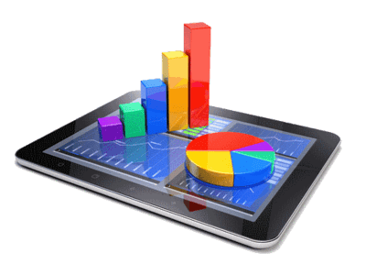

Slide 3

Data can be primary data (information collected by the investigator themselves) or secondary data (information from other sources).

Slide 4

For example, the results you collect from an experiment are primary data.
The information you get from doing research on the internet is secondary data.

Slide 5

Data can also be described as quantitative or qualitative.
Quantitative involves numerical data, for example your age in years.
Qualitative involves descriptive data, for example the colour of your hair.

Slide 6

If you measured the hand span of everyone in your class, that would be primary, quantitative data, as you collected the data yourself and it was numerical.
If you researched the colours of the different planets in our solar system, that would be secondary, qualitative data, as you collected the data from another source and it was not numerical.

Slide 7
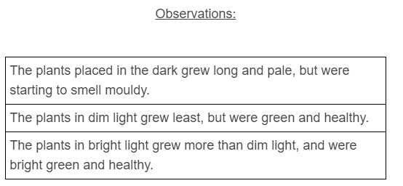
Recording observations example:
A student placed 5 bean plants in a dark cupboard, 5 in a dimly lit part of the room and 5 outside in bright sunlight.
Note: the observations recorded here are qualitative data.

Slide 8
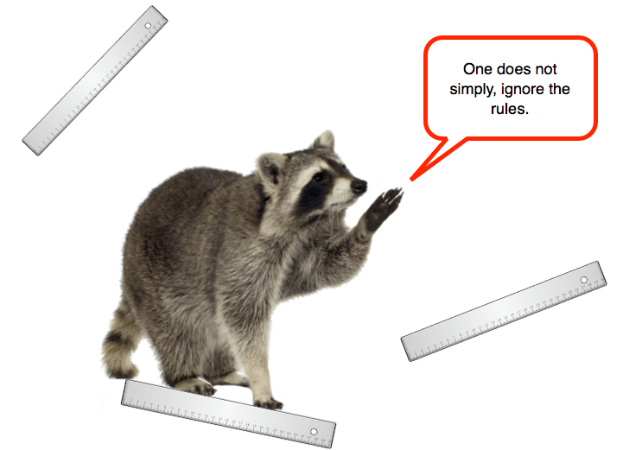
Data is often recorded in tables to make it easy to understand.
This is called tabulating the data.
There are specific rules to follow when setting up a data table.

Slide 9
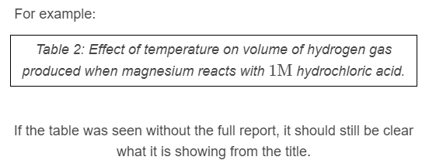
Rule 1: All tables should have a detailed title.
Often they are labelled as a table with a number, to make it easy to refer to.
They usually indicate the independent and dependent variables.

Slide 10
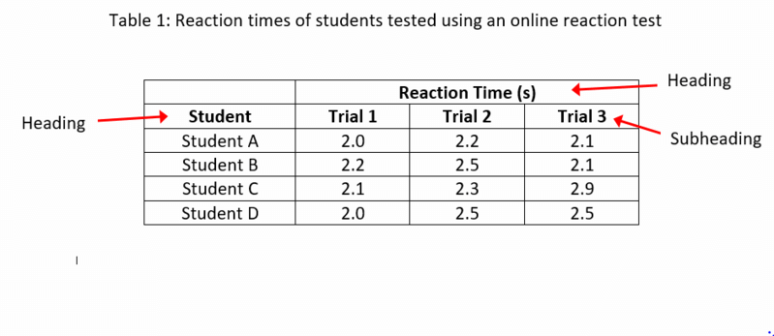
Rule 2: Tables should have clear headings.
The headings should clearly indicate what is in each row or column.
In the table below, headings show what is being changed (different students) and what is being measured (reaction time).
These are the independent and dependent variables.

Slide 11
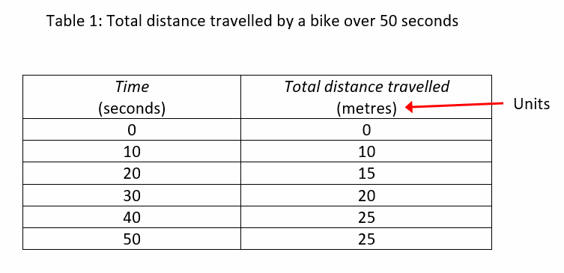
Rule 3: Units of measurement should be included in the headings of the table.
You do not need to write the units throughout the table, just in the heading.
This makes it clearer and saves time.
For example, in the table below a student is recording total distance moved by a bike every 10 seconds:

Slide 12
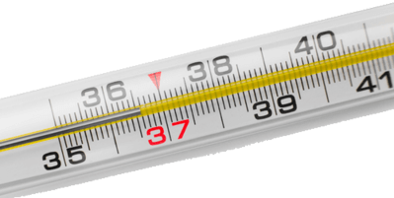
Rule 4: Data should be rounded consistently in the table.
The number of places data is rounded to depends on the accuracy of the actual measurements.
Once you decide on a suitable number of decimal places, then be consistent.
For example if a thermometer measures to the nearest 0.1∘C, then data should be recorded to the nearest 0.1∘C.
24∘C should be written 24.0∘C.

Slide 13
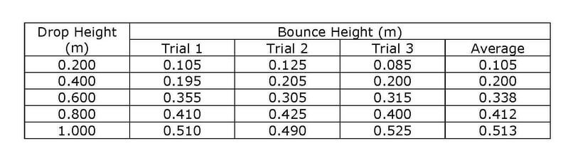
Rule 5: Where there are several trials and the results are averaged, the average should be rounded appropriately.
This will usually be to the same number of decimal places as the original data.
For example, the table below shows the results from an experiment dropping a ball from different heights and measuring how high it bounces.
Notice how all the data is rounded to 3 decimal places (3dp).

